Slide 1

CPT 175 VALEX
3 October 2019
DV INTEL BRIEF

Slide 2
Lockheed Martin’s Cyber Kill Chain
and
MITRE’s ATT&CK framework

Slide 3
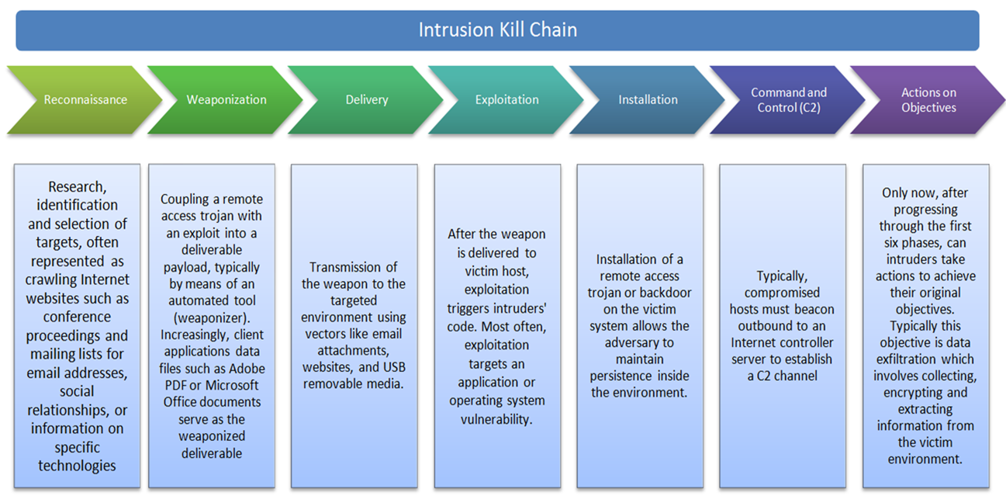
Lockheed Martin Cyber Kill Chain

Slide 4
Cyber Kill Chain and ATT&CK framework
Lockheed Martin Cyber Attack Kill Chain
Reconnaissance
Weaponization
Delivery
Exploitation
Installation
Command & Control (C2)
Actions on
Objectives
MITRE PRE-ATT&CK framework.
Priority Definition (Planning, Direction)
Target Selection
Information Gathering (Technical, People, Organizational)
Weakness Identification (Technical, People, Organizational)
Adversary OpSec
Establish & Maintain Infrastructure
Persona Development
Build Capabilities
Test Capabilities
Stage Capabilities.
MITRE ENTERPRISE ATT&CK framework.
Initial Access
Execution
Persistence
Privilege Escalation
Defense Evasion
Credential Access
Discovery
Lateral Movement
Collection Exfiltration
Command & Control

Slide 5
Identify the Target(s)
Reconnaissance
Weaponization
Delivery
Exploitation
Installation
Command & Control (C2)
Actions on
Objectives
Reconnaissance
Expected Actions of Aggressors and Defenders During
Reconnaissance
AGGRESSORS The aggressors are in the planning phase of their operation. They conduct research to understand which targets will enable them to meet their objectives.
Harvest email addresses
Identify employees on social media networks
Collect press releases, contract awards, conference attendee lists
Discover internet-facing servers
DEFENDERS
Detecting reconnaissance as it happens can be very difficult, but when defenders discover recon – even well after the fact – it can reveal the intent of the adversaries.
Collect website visitor logs for alerting and historical searching.
Collaborate with web administrators to utilize their existing browser analytics.
Build detections for browsing behaviors unique to reconnaissance.
Prioritize defenses around particular technologies or people based on recon activity.

Slide 6
Prepare the Operation
Reconnaissance
Weaponization
Delivery
Exploitation
Installation
Command & Control (C2)
Actions on
Objectives
Weaponization
Reconnaissance
Expected Actions of Aggressors and Defenders During
Weaponization
AGGRESSORS The aggressors are in the preparation and staging phase of their operation. Malware generation is likely not done by hand – they use automated tools. A “weaponizer” couples malware and exploit into a deliverable payload.
Obtain a weaponizer, either in-house or obtain through public or private channels
For file-based exploits, select “decoy” document to present to the victim.
Select backdoor implant and appropriate command and control infrastructure for operation
Designate a specific “mission id” and embed in the malware
Compile the backdoor and weaponize the payload
DEFENDERS
This is an essential phase for defenders to understand. Though they cannot detect weaponization as it happens, they can infer by analyzing malware artifacts. Detections against weaponizer artifacts are often the most durable & resilient defenses.
Conduct full malware analysis – not just what payload it drops, but how it was made.
Build detections for weaponizers – find new campaigns and new payloads only because they re-used a weaponizer toolkit.
Analyze timeline of when malware was created relative to when it was used. Old malware is “malware off the shelf” but new malware might mean active, tailored operations.
Collect files and metadata for future analysis.
Determine which weaponizer artifacts are common to which APT campaigns. Are they widely shared or closely held?

Slide 7
Launch the Operation
Reconnaissance
Weaponization
Delivery
Exploitation
Installation
Command & Control (C2)
Actions on
Objectives
Delivery
Expected Actions of Aggressors and Defenders During
Delivery
AGGRESSORS The aggressors convey the malware to the target. They have launched their operation.
Adversary controlled delivery:
Direct against web servers
Adversary released delivery
Malicious email
Malware on USB stick
Social media interactions
“Watering hole” compromised websites
DEFENDERS
This is the first and most important opportunity for defenders to block the operation. A key measure of effectiveness is the fraction of intrusion attempts that are blocked at delivery stage.
Analyze delivery medium – understand upstream infrastructure.
Understand targeted servers and people, their roles and responsibilities, what information is available.
Infer intent of adversary based on targeting.
Leverage weaponizer artifacts to detect new malicious payloads at the point of Delivery.
Analyze time of day of when operation began.
Collect email and web logs for forensic reconstruction. Even if an intrusion is detected late, defenders must be able to determine when and how delivery began.

Slide 8
Gain Access to Victim
Reconnaissance
Weaponization
Delivery
Exploitation
Installation
Command & Control (C2)
Actions on
Objectives
Exploitation
Expected Actions of Aggressors and Defenders During
Exploitation
AGGRESSORS The aggressors must exploit a vulnerability to gain access. The phrase “zero day” refers to the exploit code used in just this step.
Software, hardware, or human vulnerability
Acquire or develop zero day exploit
Adversary triggered exploits for server-based vulnerabilities
Victim triggered exploits
Opening attachment of malicious emailf
Clicking malicious link
DEFENDERS
Here traditional hardening measures add resiliency, but custom capabilities are necessary to stop zero-day exploits at this stage.
User awareness training and email testing for employees.
Secure coding training for web developers.
Regular vulnerability scanning and penetration testing.
Endpoint hardening measures:
Restrict admin privileges
Use Microsoft EMET
Custom endpoint rules to block shellcode execution
Endpoint process auditing to forensically determine origin of exploit.

Slide 9
Establish Beachhead at the Victim
Reconnaissance
Weaponization
Delivery
Exploitation
Installation
Command & Control (C2)
Actions on
Objectives
Installation
Expected Actions of Aggressors and Defenders During
Installation
AGGRESSORS Typically, the adversaries install a persistent backdoor or implant in the victim environment to maintain access for an extended period of time.
Install webshell on web server
Install backdoor/implant on client victim
Create point of persistence by adding services, AutoRun keys, etc.
Some adversaries “time stomp” the file to make malware appear it is part of the standard operating system install.
DEFENDERS
Endpoint instrumentation to detect and log installation activity. Analyze installation phase during malware analysis to create new endpoint mitigations.
HIPS to alert or block on common installation paths, e.g. RECYCLER.
Understand if malware requires administrator privileges or only user.
Endpoint process auditing to discover abnormal file creations.
Extract certificates of any signed executables.
Understand compile time of malware to determine if it is old or new.

Slide 10
Remotely Control the Implants
Reconnaissance
Weaponization
Delivery
Exploitation
Installation
Command & Control (C2)
Actions on
Objectives
Command & Control (C2)
Expected Actions of Aggressors and Defenders During
Command & Control (C2)
AGGRESSORS Malware opens a command channel to enable the adversary to remotely manipulate the victim.
Open two way communications channel to C2 infrastructure
Most common C2 channels are over web, DNS, and email protocols
C2 infrastructure may be adversary owned or another victim network itself
DEFENDERS
The defender’s last best chance to block the operation: by blocking the C2 channel. If adversaries can’t issue commands, defenders can prevent impact.
Discover C2 infrastructure thorough malware analysis.
Harden network:
Consolidate number of internet points of presence
Require proxies for all types of traffic (HTTP, DNS)
Customize blocks of C2 protocols on web proxies.
Proxy category blocks, including “none” or “uncategorized” domains.
DNS sink holing and name server poisoning
Conduct open source research to discover new adversary C2 infrastructure.

Slide 11
Achieve the Mission’s Goal
Reconnaissance
Weaponization
Delivery
Exploitation
Installation
Command & Control (C2)
Actions on
Objectives
Actions on
Objectives
Expected Actions of Aggressors and Defenders During
Actions on Objectives
AGGRESSORS With hands-on keyboard access, intruders accomplish the mission’s goal. What happens next depends on who is on the keyboard.
Collect user credentials
Privilege escalation
Internal reconnaissance of Lateral movement through environment
Collect and exfiltrate data
Destroy systems
Overwrite or corrupt data
Surreptitiously modify data
DEFENDERS
The longer an adversary has CKC7 access, the greater the impact. Defenders must detect this stage as quickly as possible by using forensic evidence – including network packet captures, for damage assessment.
Establish incident response playbook, including executive engagement and communications plan.
Detect data exfiltration, lateral movement, unauthorized credential usage.fImmediate analyst response to all CKC7 alerts.
Forensic agents pre-deployed to endpoints for rapid triage.fNetwork package capture to recreate activity.
Conduct damage assessment with subject matter experts.

Slide 12






Slide 13
Aggressors

Slide 14
Baseline Assumption and Facts
01-INITIAL ACCESS:
Most likely: Spear phishing email or drive-by website with malicious weaponized payload (executive file, macro, link, etc.).
Recommendation: Review/Search Download histories and Browser Histories.
02-EXECUTION:
Most likely: Via program execution of weaponized malicious payload by user.
Recommendation: Review/Search program execution of Scripts, PowerShell, Windows System files (misspelled)
03-PERSISTENCE:
Most likely: Will exploit via Bootkit, Component Object Model Hijacking (COM) Hijack, Hidden Files and Directories, Logon Scripts, Office Application Startup
Recommendation: Review/Search Boot Logs, DLLs, Hidden Files and Directories, Logon Scripts, Microsoft Documents & Application Startup. Compare known good baselines to active OS footprints to identify deltas.
04-PRIVILEGE ESCALATION:
Most likely: Access Token Manipulation, Exploitation of a software vulnerability for Privilege Escalation
Recommendation: Detect token manipulation by auditing command-line activity. Limit permissions so that users and user groups cannot create tokens. Search for suspicious files written to disk or evidence of Process Injection to detect Exploitation for Privilege Escalation. Recommend Application Isolation and Sandboxing. Review/Search Access Tokens, Event IDs
05-DEFENSE EVASION:
Most likely: Aggressors use several means to evade detection. May employ any of the following techniques: Obfuscate/Encode Files or Information, Exploitation for Defense Evasion, File Deletion, Indicator Removal on Host, Obfuscated Files or Information, Rootkit, Template Injection, and/or "Timestomp" technique.
Recommendation: Review/Search use of “Certutil’ command, use of CCleaner to delete files, clearing Logs via ‘wevtutil cl System’ and ‘wevutil cl Security’ commands. Snort rules alert based on payloads encoded with Base64. Search for Rootkits and MSOffice template injection. Compare known good baselines to identify Timestomping activities.

Slide 15
Baseline Assumption and Facts
07-DISCOVERY:
Most likely: APT 82 may employ Network Sniffing, File and Directory Discovery (recursion), Peripheral Device Discovery, Process Discovery
Recommendation: Alert on any use of ‘Forfiles’ to loocate PDF , Excel, and Word docs. Use of Responder to sniff docs coming across network. Use of ‘Tasklist’ command and utility. Use of ps utility on Linux systems.
08-LATERAL MOVEMENT:
Most likely: APT 82 may employ Exploitation of remote services SMB, RDP, MySQL.May implant ‘Logon’ scripts when a user logs on. Use of Pass the Hash method. Remote file copy in Windows through FTP, in Linux through scp, rsync, and sftp.
Recommendation: Enforce following-- 1. Password Policies: (complex, unique passwords), 2. Privileged Account Management: Limit credential overlap across systems, 3. Update Software (patch), 4. User Account Control: Enable pass the hash mitigations to apply UAC restrictions to local accounts on network logon, and 5. User Account Management: Limit local administrator to one system per privileged user.
09-COLLECTION:
Most likely: APT 82 may employ Automated Collection, Data Staged, Data from Information Repositories, Data from Local System, Data from Removable Media, Email Collection, Input Capture, and Screen Capture.
Recommendation: Review/Search use of custom scripts to search and collect data. Also use of search from cmd line. Collected data is staged at a central location prior to exfiltration. Data is compressed or encrypted. Review/Search use of se of email, keyloggers, and screen capture.
10-EXFILTRATION:
Most likely: APT 82 may employ data encoding and compression prior to exfiltration.
Recommendation: Review/Search use of 7zip, RAR, ZIP, zlib to compress files prior to exfiltration.
11-COMMAND & CONTROL:
Most likely: Aggressors may employ Connection Proxy, Custom Cryptographic Protocol, Data Obfuscation, Standard Application Layer Protocol.
Recommendation: Review/Search Traffic redirection through Proxies or Port Redirection (HTRAN, ZXProxy, ZXPortMap. XOR-ing plaintext to hide CC traffic. Also adding ‘Junk Data’ to communications hides, but does not encrypt. Communicate through application layer traffic (HTTP, HTTPS, SMTP, DNS) to avoid detection by blending in with existing traffic.

Slide 16
Observed Enemy Actions

Slide 17
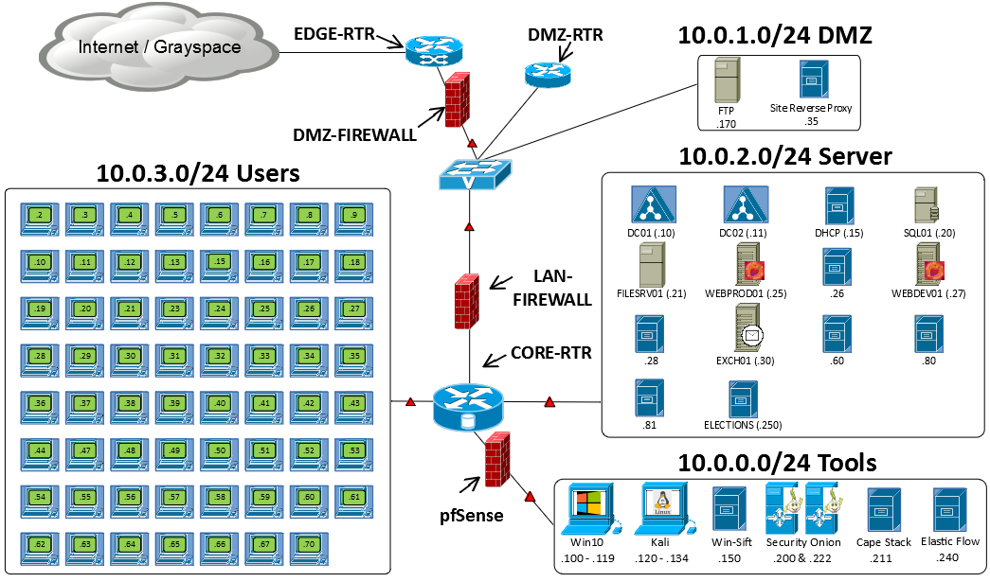

Indicators of Compromise
Malicious Script/Drive-By
20191001:1103 – User: Andres.E.Caller visited a malicious website and caused a ‘Drive-By-Download’ of malicious file named ‘CHOST.exe’ on to workstation host 10.0.3.2
IR team manually found CHOST.exe on host
Support team scanned remaining boxes with Gh0stHunt framework, and found CHOST.exe on 10.0.3.24
SOC detected beaconing from CHOST.exe to malicious IP’s which led to attribution.
10.0.3.2
GROUND ZERO
Key
Compromised Host
Likely Incursion
Beacon
Reconnaissance
Weaponization
Delivery
Delivery
Exploitation
Installation
Command & Control (C2)
Actions on
Objectives
Scanning
Script
Drive-by-Download
Malware
Beaconer
Beaconing

Slide 18
Indicators of Compromise
Malicious Script/Drive-By
20191001:1114 – Malware CHOST detected on additional workstation 10.0.3.24
SOC detected beaconing from CHOST.exe to malicious IP’s from second compromised host
Key
Compromised Host
Likely Incursion
Beacon
Reconnaissance
Weaponization
Delivery
Delivery
Exploitation
Installation
Command & Control (C2)
Actions on
Objectives
Scanning
Script
Drive-by-Download
Malware
Beaconer
Beaconing

Slide 19
Indicators of Compromise
Boot Script
20191002:1239 – DC02 found to be compromised via a scheduler exploit
20191002:1614 – DC01 anomalies revealed Kerberos likely compromised.
20191001:1730 – Finance workstation10.0.3.23 found to be compromised via a scheduler exploit
Key
Compromised Host
Likely Incursion
Beacon
Reconnaissance
Weaponization
Delivery
Delivery
Exploitation
Installation
Command & Control (C2)
Actions on
Objectives
Scanning
Script
Drive-by-Download
Malware
Beaconer
Beaconing
Boot/Logon Script
Scheduler

Slide 20
Indicators of Compromise
Process Injection
20191002:0914 – In Users range 10..0.3.x on xxx.2 and xxx.24, “CHOST” process injected into rundll and rdpclip
Domain compromised, MimiKatz detected. Lateral movement likely.
1033 GB exfiltrated data from Server enclave via tiny packets over port 80.
Key
Compromised Host
Likely Incursion
Beacon
Reconnaissance
Weaponization
Delivery
Delivery
Exploitation
Installation
Command & Control (C2)
Actions on
Objectives
Scanning
Script
Drive-by-Download
Malware
Beaconer
Beaconing
Data Exfil
Boot/Logon Script
Scheduler
Lateral Movement
Process Injection

Slide 21
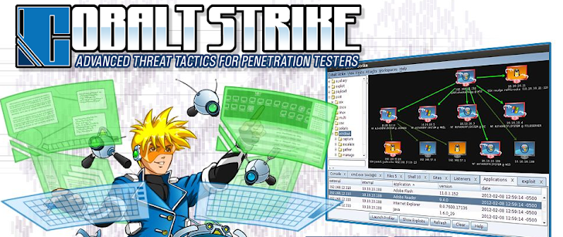
As of: 20191003:0800
Day 3
Attribution
Attribution
Threat actors believed to be using Cobalt Strike or similar tool.
Supporting Evidence for Cobalt Strike
Process injection in VDS.exe connecting to identical remote IPs as CHOST.exe pointing to C2 activity
LSASS injection indicates Pass the Hash and use of MimiKatz
Base64 Encoded string on DC01 indicates encoded use of Sysinternals PSEXEC and Powershell
Key
Compromised Host
Likely Incursion
Beacon
Suspected C2
Reconnaissance
Weaponization
Delivery
Exploitation
Installation
Command & Control (C2)
Actions on
Objectives
Scanning
Script
Drive-by-Download
Malware
Beaconer
Beaconing
Data Exfil
Boot/Logon Script
Scheduler
Lateral Movement
Process Injection

Slide 22
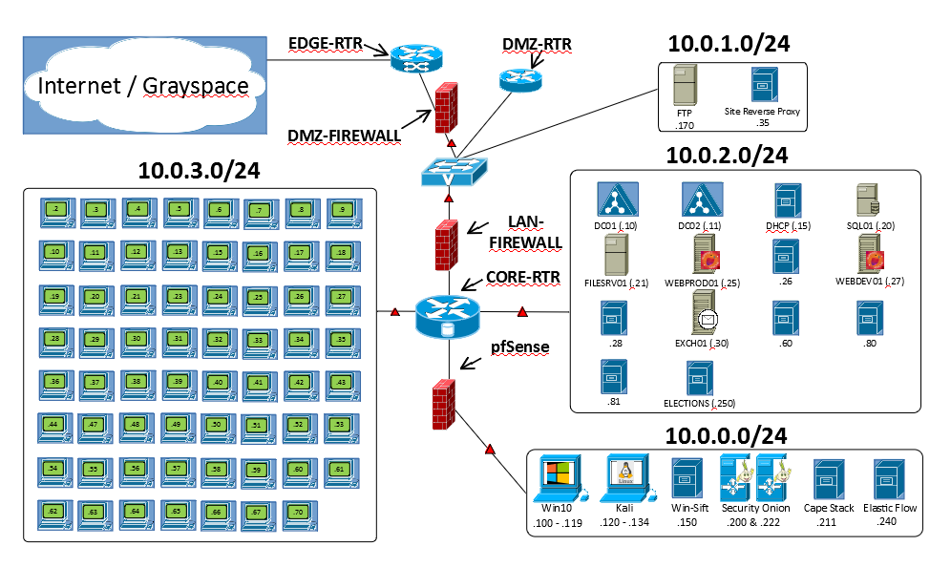

Indicators of Compromise
Evidence
The PowerShell payload remotely executed a script that runs in memory on the local machine.
HBSS and preliminary inspection of the payload show that the exploit was Swrort.i (metasploit framework)
200.200.225.4
200.200.225.5
200.200.225.4
200.200.225.5
KEY
Payload
Reconnaissance
Weaponization
Delivery
Exploitation
Installation
Command & Control (C2)
Actions on
Objectives
Scanning
PowerShell
Boot/Logon Script
PowerShell
Drive-by-download
Metasploit

Slide 23
Indicators of Compromise
200.200.225.4
200.200.225.5
200.200.225.4
200.200.225.5
KEY
Payload
Evidence
Swrort.i malware identified on host machines
Reconnaissance
Weaponization
Delivery
Exploitation
Installation
Command & Control (C2)
Actions on
Objectives
Scanning
PowerShell
Wateringhole
PowerShell
Swrort.i
Spear-phishing
Metasploit
Drive-by-download
Notes:
<number>

Slide 24
Indicators of Compromise
Evidence
All direct communication with the compromised hosts and the external IPs used HTTP through our proxy
Initial C2 and actions
Possible C2
Periodic DNS queries to NXDOMAIN originating from compromised hosts
Ex. Cmnyrjkw.sanbox.lan
200.200.225.4
200.200.225.5
200.200.225.4
200.200.225.5
Reconnaissance
Weaponization
Delivery
Exploitation
Installation
Command & Control (C2)
Actions on
Objectives
Scanning
PowerShell
Wateringhole
PowerShell
Swrort.i
HTTP
Spear-phishing
Metasploit
DNS
Drive-by-download

Slide 25
Indicators of Compromise
Evidence
Pivot to DC01 via NETBIOS
Anomalous IPC$ mapping immediately following execution of payload on host machines
\\DC01\IPC$
Harvesting credentials from the DC
Mrs. Ramsey Bolton account logging in from the DC to the Fileserver
200.200.225.4
200.200.225.5
200.200.225.4
200.200.225.5
Reconnaissance
Weaponization
Delivery
Exploitation
Installation
Command & Control (C2)
Actions on
Objectives
Scanning
PowerShell
Wateringhole
PowerShell
Swrort.i
HTTP
Lateral Movement
Spear-phishing
Metasploit
DNS
Credential
Harvesting
Drive-by-download
Persistence

Slide 26
Network Activity Timeline
Date / Time | Host / Network | Description | Attribution
20-24 APR | JOC Staff HHC Server Net | HBSS identified and removed malicious executables found from GET requests to White Cell management IP space. HBSS also identified but did not remove/block malicious batch files that then were executed on hosts machines. *Intel indicates a successful PEPE campaign including successful data exfiltration from the JTF Bear Defense Network and persistence | PEPE
26-27 APR | J6 HHC Server Net | Identified scans originating from external IP space 200.200.225.0/24 GET requests to python SimpleHTTPServer on port 8000 to same external IP space PowerShell script from GET request connects to same IPs on port 443 and downloads a PowerShell payload that is base64encoded Following the execution of the payload observed an anomalous local share is established from the host to the DC (\DC01\IPC$) indicating lateral movement to the domain controller DNS beacon for C2 from hosts to DC1 after payload execution | PEPE

Slide 27
Mitigation Techniques

Slide 28
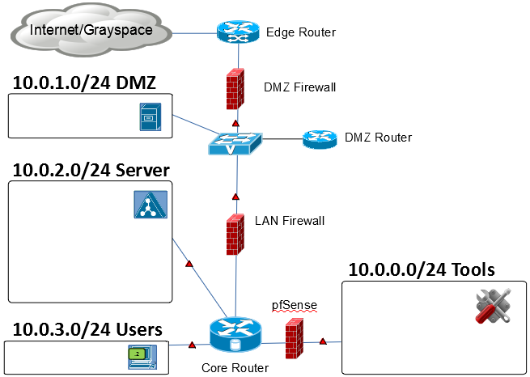
Harden Recommendations
Network
Implement Access control lists within routers/Firewalls:
Access control lists should be defined permitting only the required traffic
Reduce risk of unauthorized lateral movement
Deny externally established connections into Network
Harden Router/Firewall User Account Access
Restrict management access to a defined list of internal hosts, using only encrypted protocol such as SSH
FTP
Site Reverse Proxy
DC01/DC02
DHCP
Web PROD
Web DEV
Exchange
File Server
MS SQL
Other Misc.
Kali
Security Onion
Win-SIFT
CAPE Stack
Elastic Flow
Jump Boxes
Workstations

Slide 29
Harden Recommendations
Workstations
Disable administrator accounts on machines
Disable guest accounts
Remove miscellaneous accounts
Disable all unnecessary services
Enable host firewalls & ensure all system firewalls are turned on with standardized rules
Update workstations with latest patches
Microsoft patches
All other vendor patches
Servers
Create a backup of the database instance
Reassign the MSSQL to a non-standard port
Turn off SQL Server browser service
Turn off named pipes
Disable unnecessary services
Restrict access to the DB backup
Patch the system to the latest KB
FTP
Site Reverse Proxy
DC01/DC02
DHCP
Web PROD
Web DEV
Exchange
File Server
MS SQL
Other Misc.
Kali
Security Onion
Win-SIFT
CAPE Stack
Elastic Flow
Jump Boxes
Workstations
Notes:
<number>

Slide 30
Fortify Recommendations
Active Directory
Enable Windows Firewalls for domain client machines
Disable HTTP listeners and use WinRM over HTTPS
Deploy Sysmon to monitor AD domain controllers
Deny user write to unauthorized locations
Enforce strong password policy
Complex password required
Enforce Password expiration
Password age set to 60 days to lock inactive accounts
FTP
Site Reverse Proxy
DC01/DC02
DHCP
Web PROD
Web DEV
Exchange
File Server
MS SQL
Other Misc.
Kali
Security Onion
Win-SIFT
CAPE Stack
Elastic Flow
Jump Boxes
Workstations

Slide 31
Questions

